Slide 1

Enhancing Race Performance Predictions
Insights from F1 Data Analysis

Slide 2


F1 Industry
In Formula 1, every millisecond counts! Data is used significantly to help teams get their best outcome. Teams utilize predictive models and simulations to anticipate track conditions and competitor performance, helping teams decide the optimal race strategy.
Detailed analysis of past starting positions and race outcomes is used to drive strategic decisions, such as managing tire wear and adapting to evolving track conditions. This enables teams to maximize their qualifying performance, securing advantageous starting positions for the race.

Slide 3

Objective
To develop a model that accurately predicts race finish times based on starting grid position, number of pit stops, laps and circuit type.

Slide 4




Designing a Linear Regression Model
Data Collection & Exploration:
Model Creation
Model Evaluation
Utilizing the 262 races data from 2000 – 2023.
Examine each variable, clean data & normalize.
Choosing appropriate dependent variables for our model.
Assessing model accuracy through R2 and Root Mean Square Error (RMSE).

Slide 5
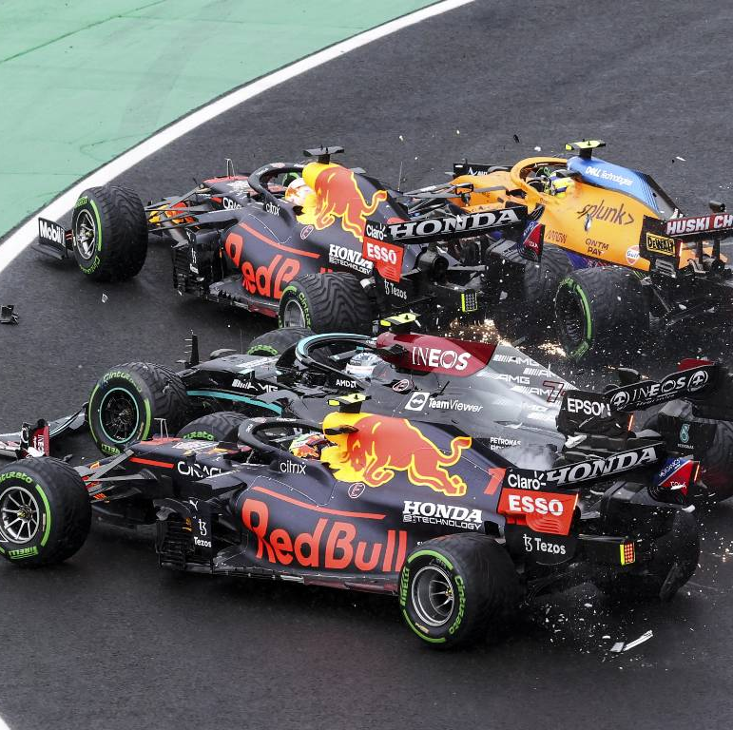
Addressing Missing Values
From 2000 – 2023 there has been 706 missing values in the race finish times.
After investigating the Missing Values, this is due to ’Did Not Finish’ race.
Since the missing values are ‘Not Missing at Random’, we will not be removing to avoid the analysis from being bias.
Data Collection & Exploration
Model Creation
Model Evaluation

Slide 6
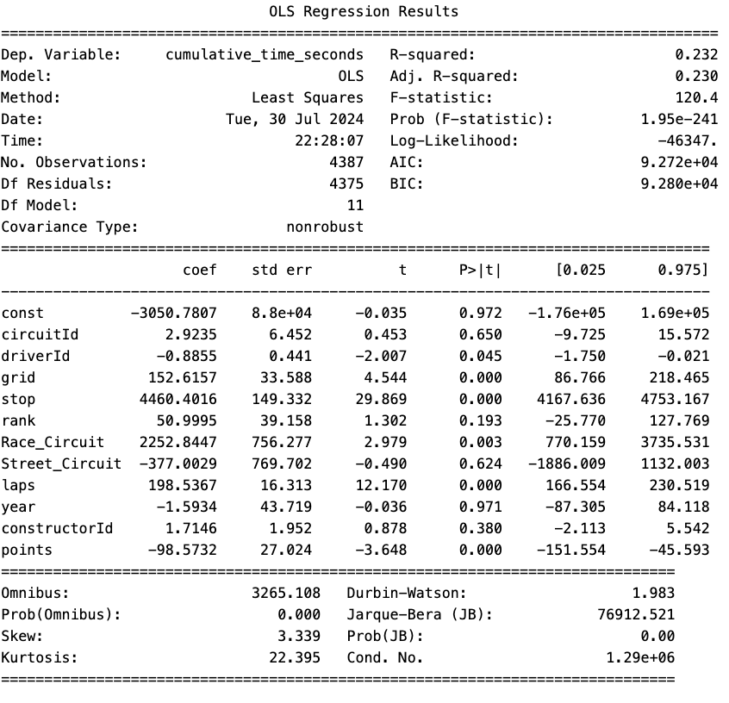
Variables to be Assessed
VARIABLES AVAILABLE FOR THE MODEL
CircuitID: Unique identifier to circuit
DriverID: Unique Identifier to the driver
Grid: Starting position of the driver in beginning of the race
Stop: Number of pitstops take during the race
Rank: The rank of the driver in the F1 season
Race_Circuit: 0 or 1 indicator to identify if the track is racing circuit
Steet_Circuit: 0 or 1 indicator to identify if the track is racing circuit
Laps: number of laps completed during the race
Year: The year the race was taken
ConstructorID: Unique Identifier to the team
Points: Number of points the driver has in the F1 season
Data Collection & Exploration
Model Creation
Model Evaluation

Slide 7
Evaluation of Variables
VARIABLES TO BE REMOVED/ ADJUSTED
CircuitID – REMOVED: Given p-value is 0.650 is greater than 0.05, this has no significance in model
DriverID - REMOVED: Given p-value is 0.045 is very close to 0.05, this variable is less significant than the others
Grid - ADJUSTED: This variable is significant given the p-value is less than 0.05, to improve model's accuracy this variable can be further broken down by Circuit Type (Race vs. Street)
ConstructorID - REMOVED: Given p-value is 0.380 is greater than 0.05, this has no significance in model
Points - REMOVED: The number of points are by DriverID, given we have determined DriverID is not significant. This variable is no longer relevant.
Data Collection & Exploration
Model Creation
Model Evaluation

Slide 8
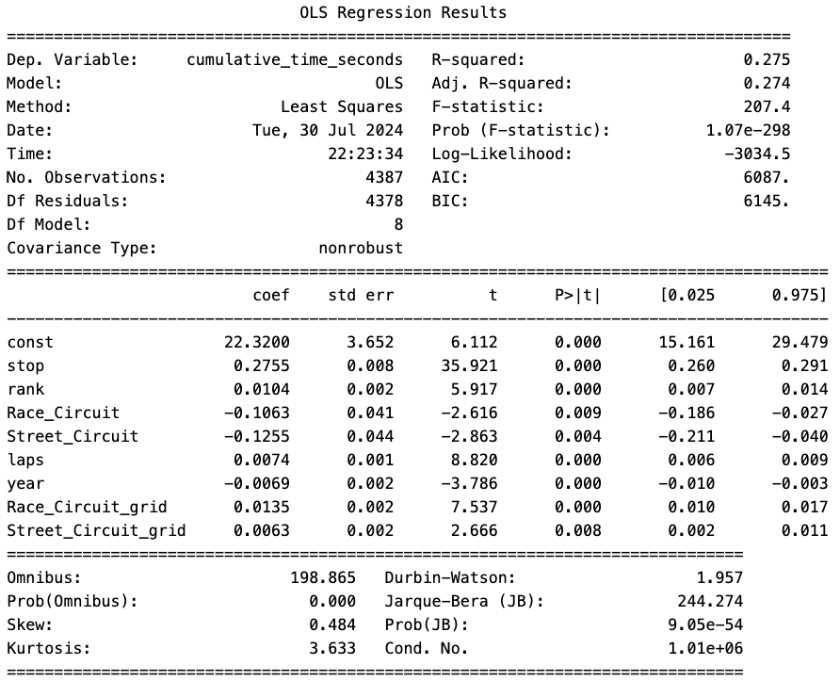

Improvement of Model Accuracy
MODEL RESULTS
Overall accuracy of the model increased from 23% to 27%
F-Stat is less than 0.05, implying at least one of variables noted below is significantly related to race time predictions
All included variables are significant to the model given their p-values are all less than 0.05
Data Collection & Exploration
Model Creation
Model Evaluation

Slide 9
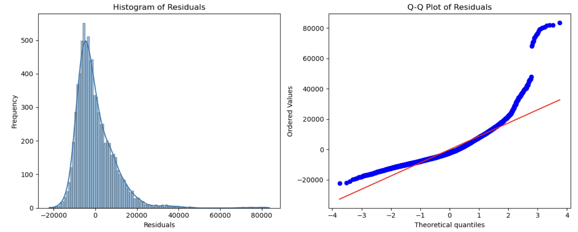
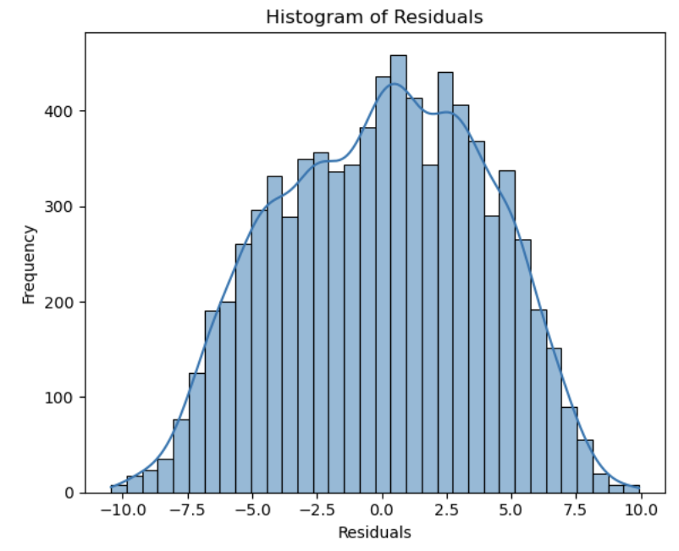
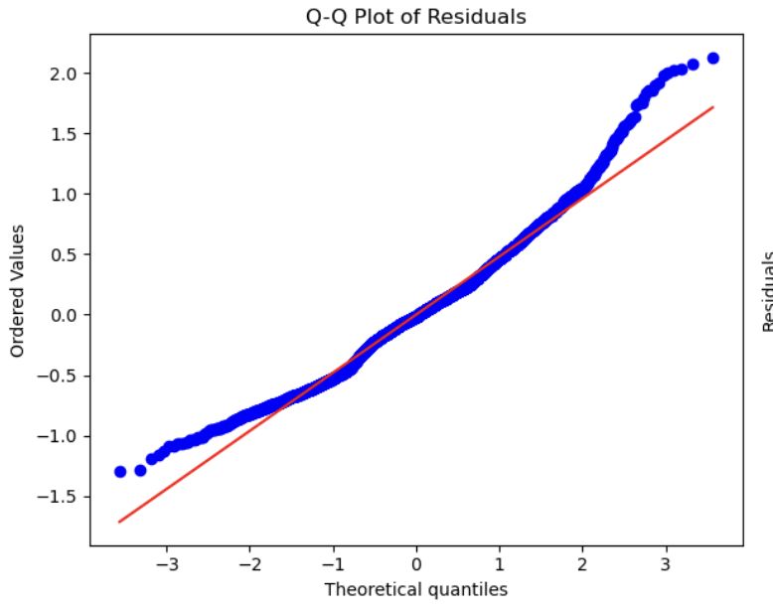

Race Time Data Was Skewed
RESULTS FROM PRELIMINARY MODEL
RESULTS FROM UPDATED MODEL
Data is right-skewed, potentially from:
Performance of Drivers: Depending on the driver’s skills they may have slower times leading to right skewed.
External Factors: Due to race incidents a safety car deployment maybe deployed which can lead to slower times which leads to right skewed.
Stabilized Variance making the model more reliable
Linearized Relationships using the natural logarithm to convert any exponential trends present in data into a linear trend.
Reduced Skewness using the natural logarithm to make it more normally distributed, which many statistical methods assume.
Apply Natural Log
To address the wide range of values and exponential growth patterns
Data Collection & Exploration
Model Creation
Model Evaluation

Slide 10
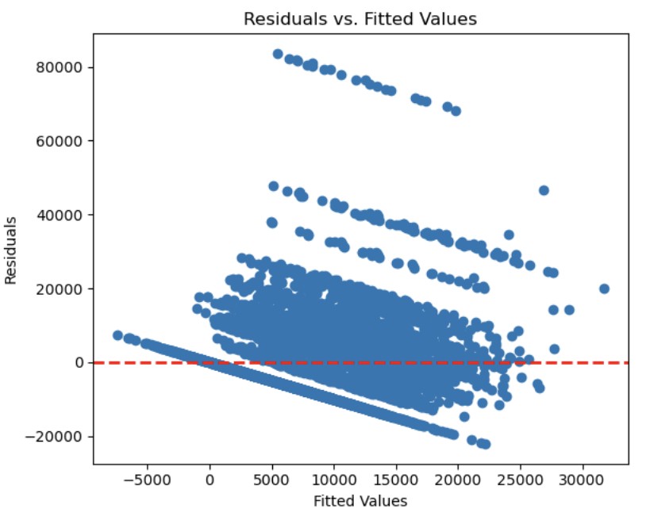
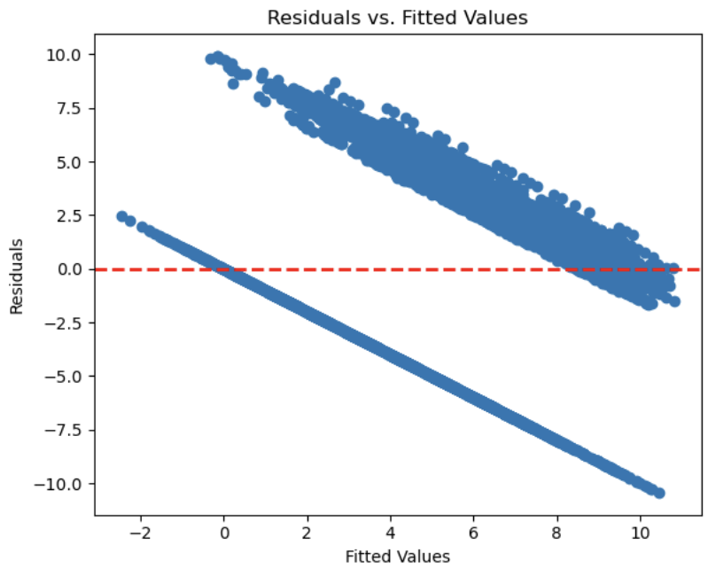
Handling Heteroskedasticity
RESULTS FROM PRELIMINARY MODEL
RESULTS FROM UPDATED MODEL
Apply Weighted Least Squares
This regression method assigns different weightings to different data points based on their variance
The plot above does not show any cone shapes to prove heteroskedasticity, however the Breusch-Pagan Test proves there is heteroskedasticity.
Meaning the finish race times and the dependent variables are not the same across races (ex. circuit, starting grid position).
Helping the prediction be more accurate by balancing the uneven spread.
Data Collection & Exploration
Model Creation
Model Evaluation

Slide 11
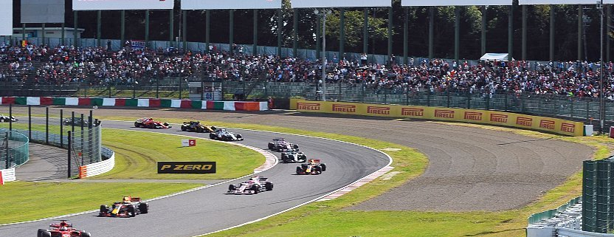
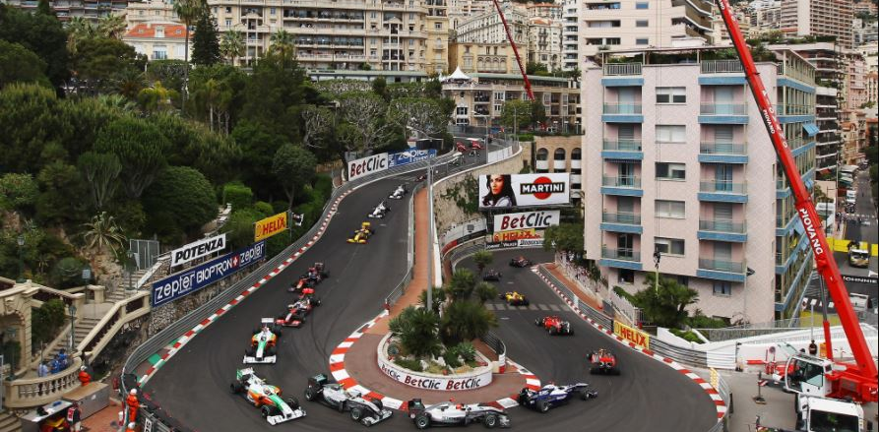
Difference Between Street and Race Circuits
Since the data has heteroskedasticity, meaning the finish race times and the dependent variables are not the same across races.
Why test for the different circuits?
Different circuits present unique challenges and opportunities. For example, street circuits might have more sharp turns and shorter straights compared to race circuits, affecting overall race times.
Understanding these differences allows teams to tailor their strategies for each race type, potentially leading to better performance and outcomes.
Race Circuit
Street Circuit
Data Collection & Exploration
Model Creation
Model Evaluation

Slide 12

Final Model Results
Our final mode showed an R² of 31% with an RMSE of 3.937.
This indicates that the model has some predictive power but there is still a significant portion of the variance that is not captured by the model.
More variables will need to be explored to create a more accurate model to predict final race times.
Examples: Weather data, tire types and driver experience
Variables included in our Final Model:
Street Circuit
Race Circuit
Number of Pitstops Completed
Number of Laps Completed
Rank of the Driver
Year the race was conducted

Slide 13

Model Insights
The higher the starting position the better race outcome you will get.​
Type of circuit (race vs. street) generate differences in time
Looking at our coefficient for grid, the higher you are in the starting position the lower your finishing time will be.​
With our P values we can see that all our variables have an influence on race time.

Slide 14
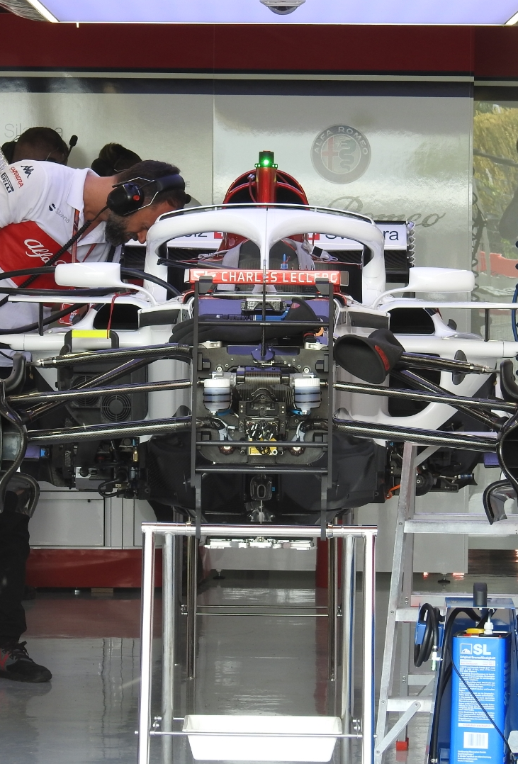
Implications for future F1 Races
With this model race teams on race day (knowing there starting grid position and type of circuit) could build a race strategy.
Example how many stops should we make to get the lowest race time?
Other variables to consider that cannot be controlled that could impact the race times:
Drivers getting into a crash.
Car problems (Engine Failure, Tire Popping)

Slide 15



Race Strategy Optimization
Model Applications
Performance Analysis
Increasing the Odds
Teams could use the model to simulate different circuits in order to create the best racing strategy
This model can be also used to conduct performance analysis for each driver among different circuits and conditions.
Betting outcome for drivers' final position will be more accurate with this model

Slide 16
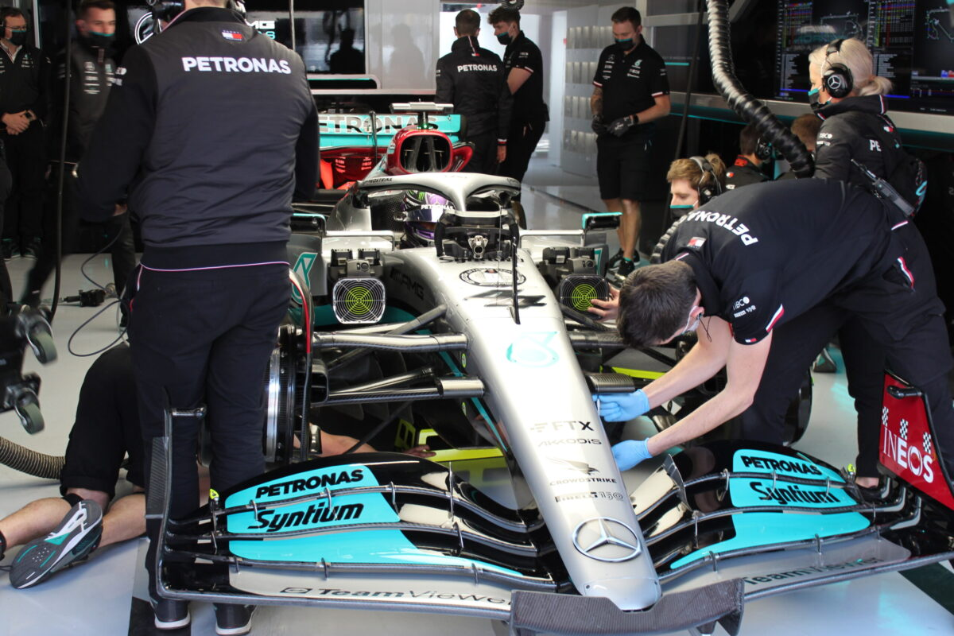
Recommendations to Improve the Model
Continuous Monitoring: Regularly monitor the quality of data and the model.
Model Updates: As more data becomes available, test and update model for accuracy.
More data: We were only able to get access to certain datasets, we recommend adding more variables such as driver skills, tire selection and weather conditions.

Slide 17

Technical Appendix

Slide 18
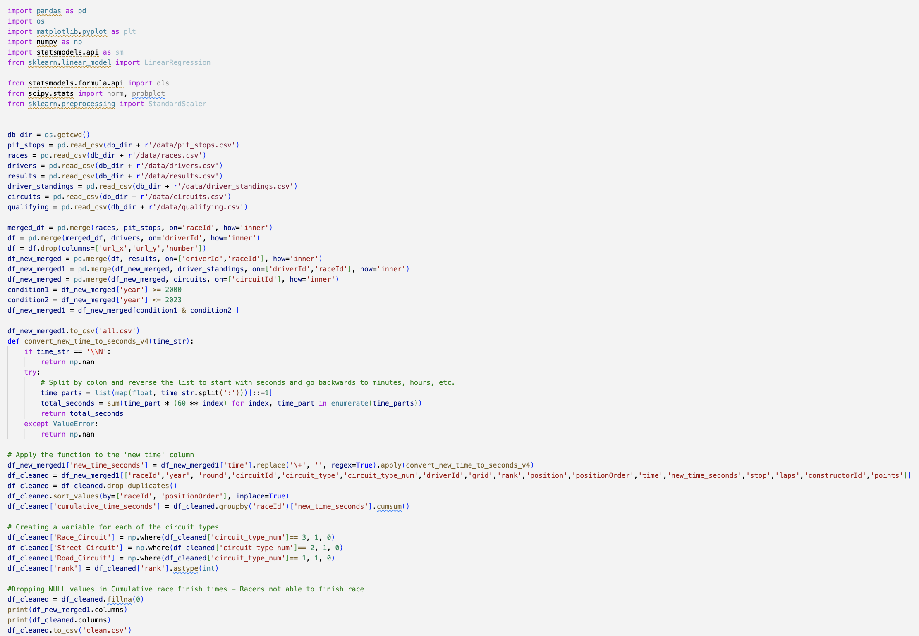

Technical Appendix: Data Import and Cleaning
Data is coming from the Ergast F1 API http://ergast.com/mrd/
For this we will only be looking at races from 2000 – 2023
Created Dependent value (Y) for our prediction
Created a dummy variable for our different types of circuits

Slide 19
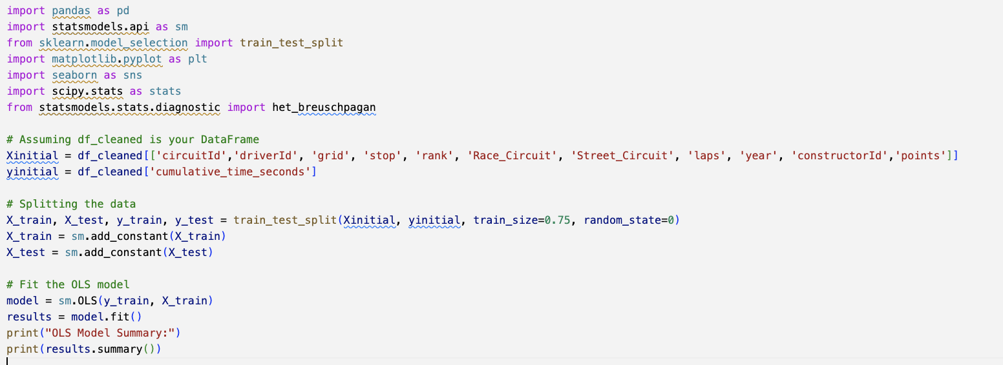
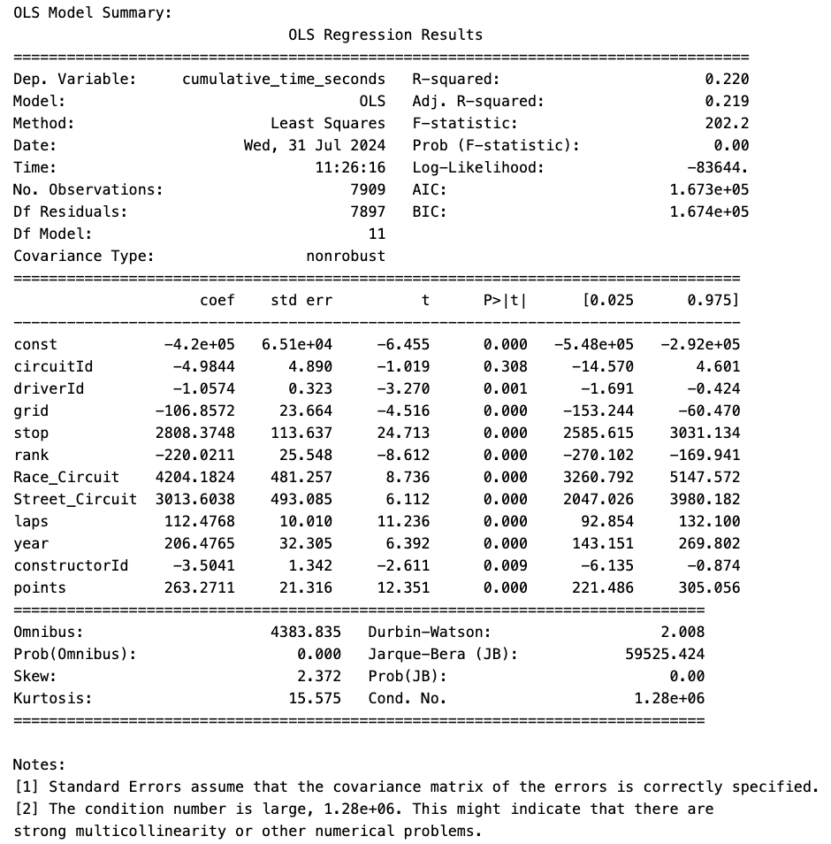
Technical Appendix: Code: Model Before Applying Any Treatment
Identify variables to use for our model.
Chose .75 for our train/test data size.
Analyze each of the variables to see how they reflect the R2 and F-Statistic.

Slide 20
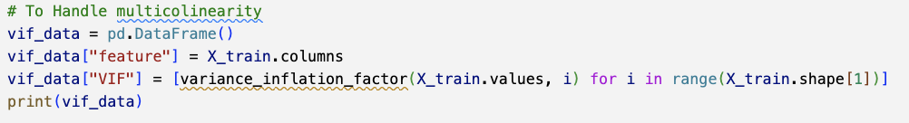
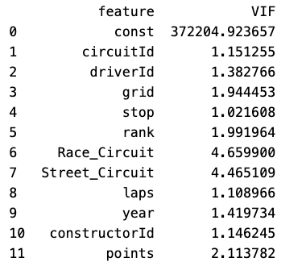
Technical Appendix: Data Import and Cleaning – Handling Multi-Collinearity
We applied the Variance Inflation Factor (VIF) to each independent variable to identify highly correlated variables.
Any variable higher than 10 will need to be removed for multi-collinearity.
Since the variables are not above 10, we don’t need to remove any variables.

Slide 21
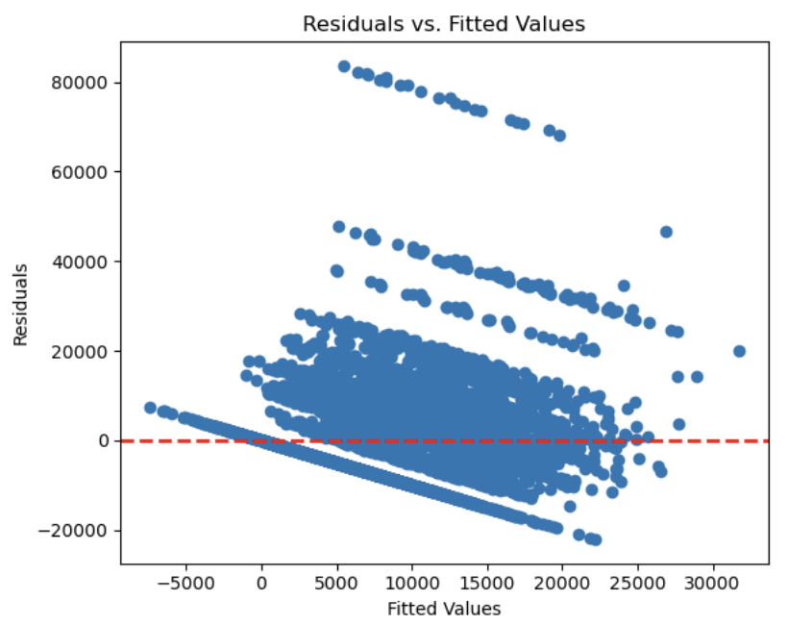
Technical Appendix: Code: Results from Exploring Data
Normality: Data was right Skewed
Q-Q Plot: looking at the tails, the data had outliers,
Residual Plot and Breusch-Pagan Test: Plot did not have a cone shape but after reviewing the Breusch-Pagan Test it had a P value (1.4817501629469654e-27) meaning it has heteroskedasticity.

Slide 22
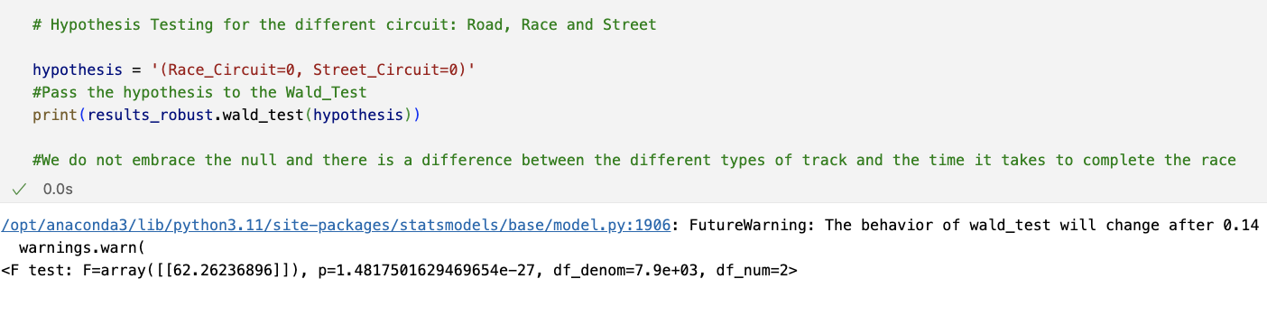
Technical Appendix: Code: Improving Results to due heteroskedasticity
Since the data has heteroskedasticity, meaning the finish race times and the dependent variables are not the same across races.
We could see if there is a difference between the different types of circuits and the race finish times.
Since P value (1.4817501629469654e-27) is less than 0.05, there is a difference between the different types of circuits.

Slide 23
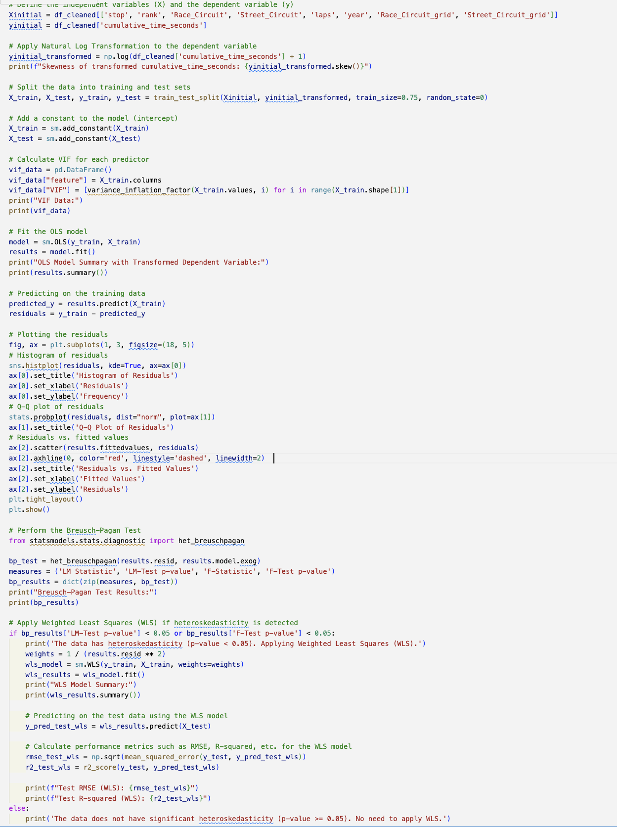
Technical Appendix: Code - Model with Treatment
Treatments applied to the model:
Creating dummy variables for the different types of circuits
Applying a Natural Log Transformation to handle the very wide range of values or exponential growth patterns
Applying a Weighted Least Squares is a regression method that assigns different weights to different data points based on their variance. Weighted Least Squares is a regression method that assigns different weights to different data points based on their variance.

Slide 24
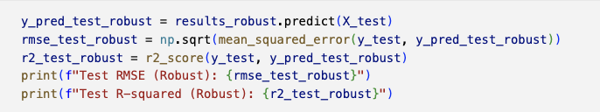
Technical Appendix: Results of the Model
Treatments applied to the model:
Creating dummy variables for the different types of circuits
Applying a Natural Log Transformation to handle the very wide range of values or exponential growth patterns
Applying a Weighted Least Squares is a regression method that assigns different weights to different data points based on their variance. Weighted Least Squares is a regression method that assigns different weights to different data points based on their variance.

